Slide 1
Component Techniques
Lifecycle methods
Effect hooks
Annexes
Memoization
REST services

Slide 2
1. Lifecycle Methods
Overview
Lifecycle methods available
Implementing lifecycle methods
Optimizing UI updates
Is an update necessary?
Accessing previous state

Slide 3
Overview
Roadmap for this chapter…
This section - lifecycle methods (class components)
Next section - effect hooks (functional components)
For a class component, React calls these methods:
Constructor
Lifecycle methods
render()

Slide 4
Lifecycle Methods Available
Here are the most common lifecycle methods that React calls upon a class component
componentDidMount()
componentDidUpdate()
componentWillUnmount()
For a full list of lifecycle methods, see:
https://reactjs.org/docs/react-component.html

Slide 5
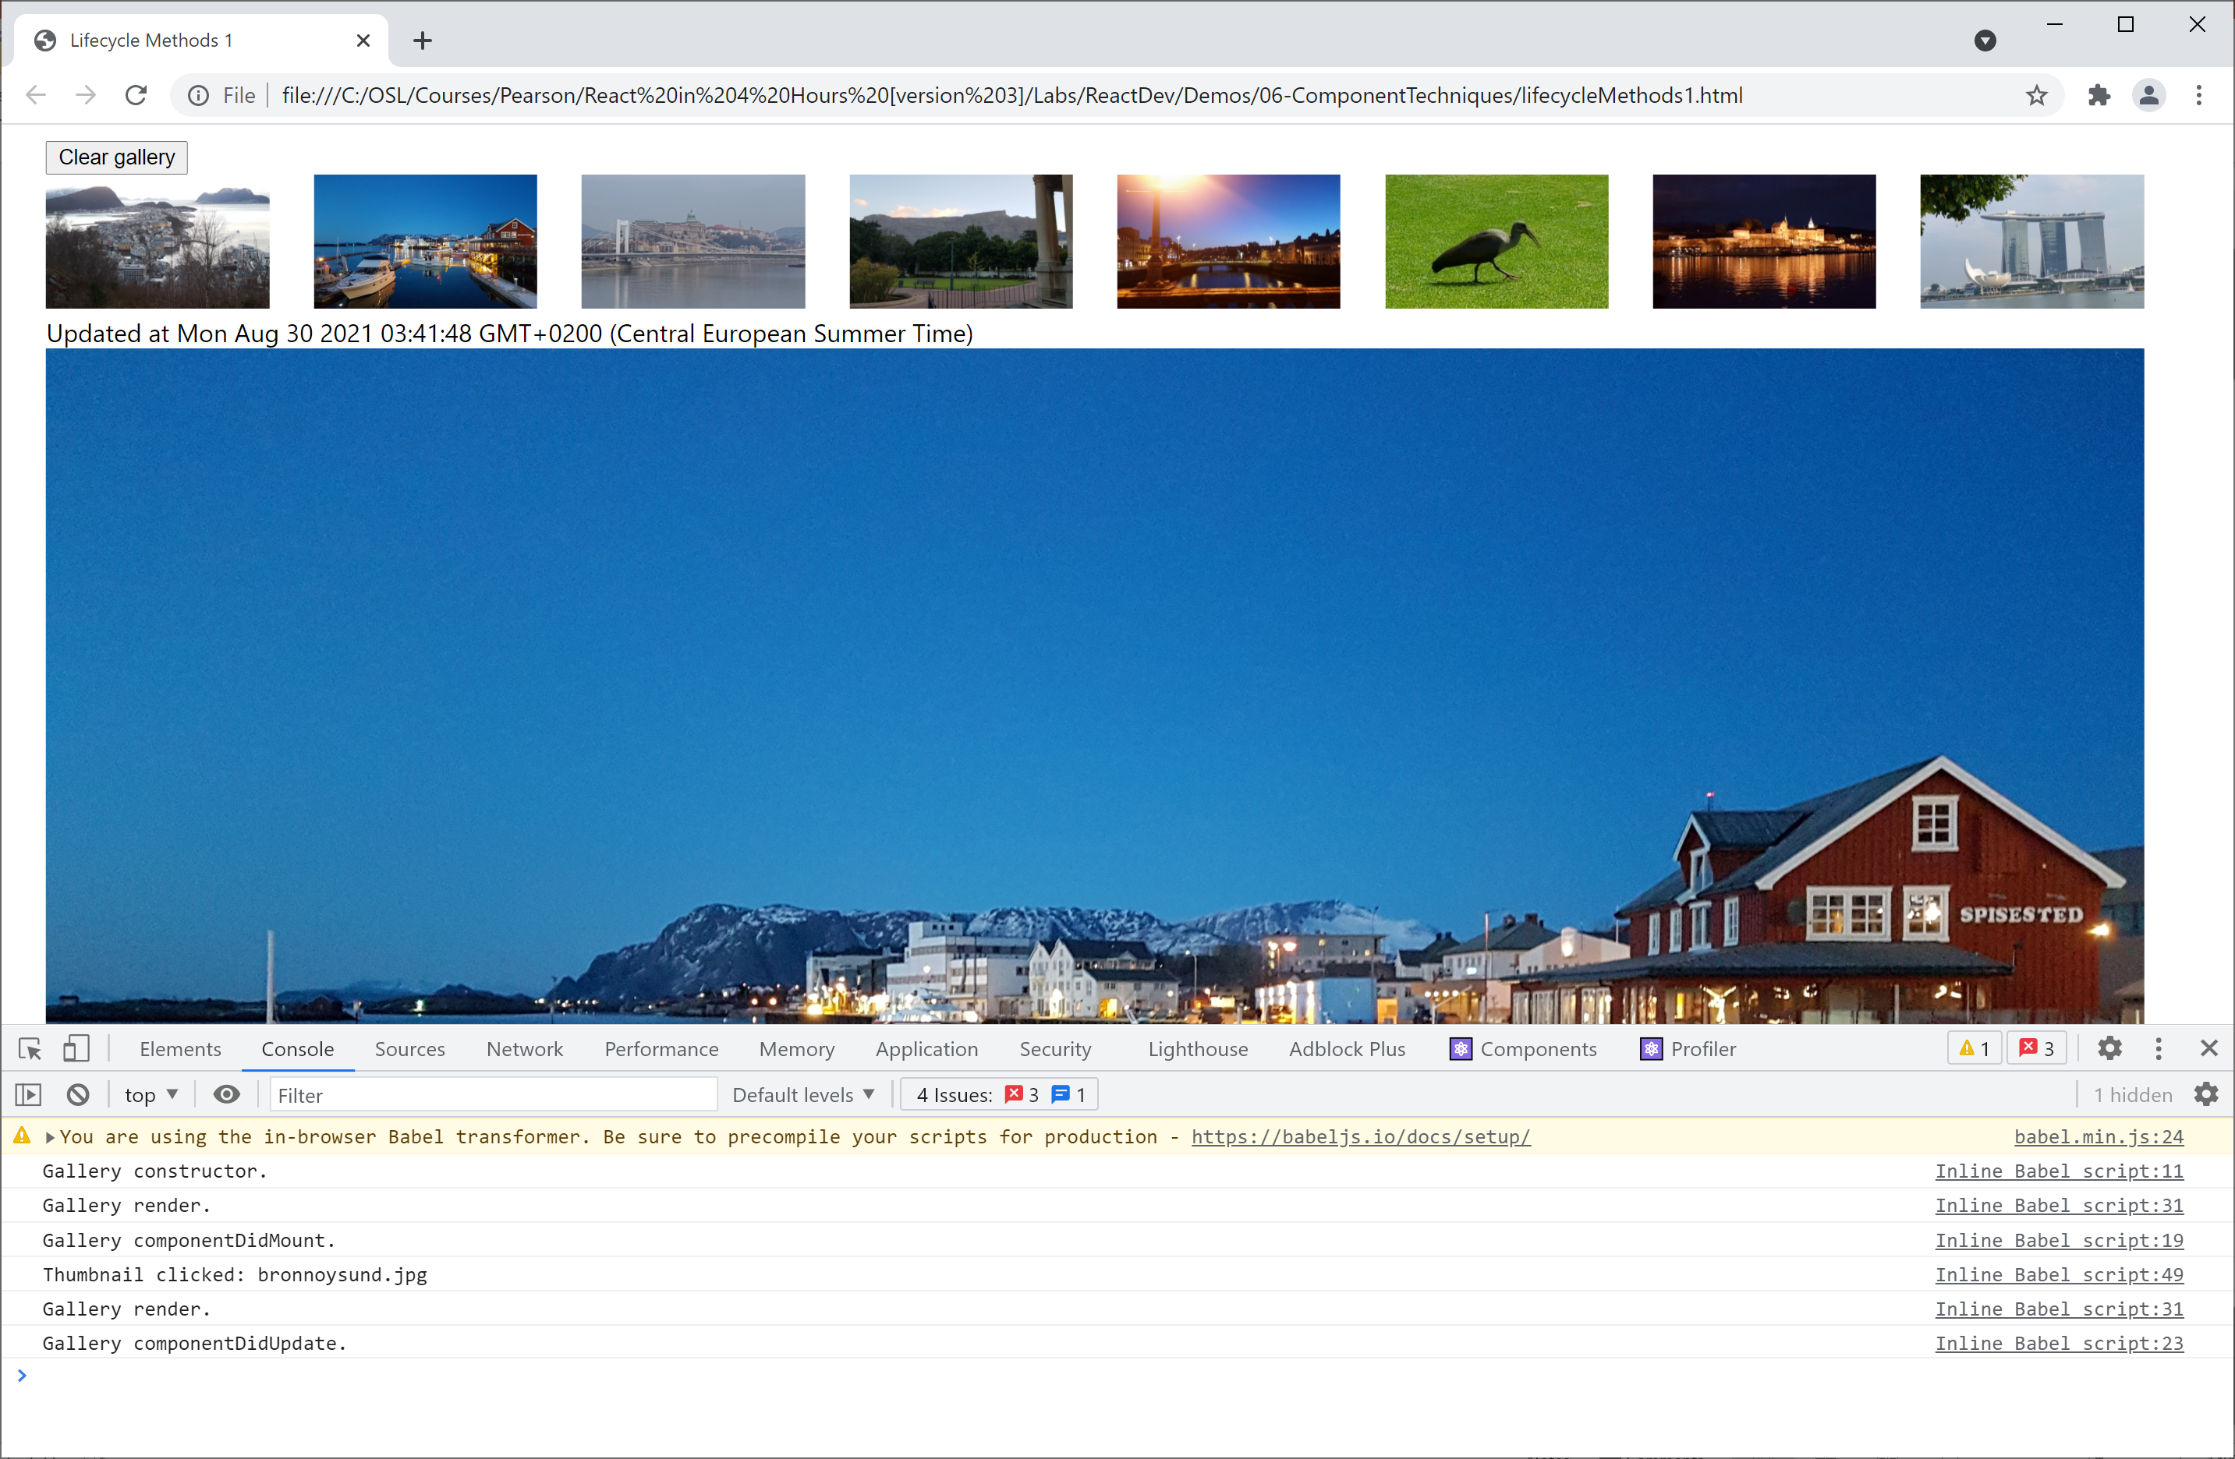
Implementing Lifecycle Methods
See the example in lifecycleMethods1.html
Displays info messages in the console

Slide 6
Optimizing UI Updates
Let's think about how we can optimize UI updates, to reduce the amount of re-rendering
At the moment, when the user clicks a thumbnail icon, it renders that icon in large format on the page
It does this even if you click the same thumbnail several times - what a waste of effort!
A better approach:
Only re-render if a different thumbnail is clicked

Slide 7
Is an Update Necessary?
Implement shouldComponentUpdate() method
The method receives the provisional new properties and state for the component
The function must return a boolean result
true if you want an update/render to happen
false if you decide there's no need to update/render
Example - see lifecycleMethods2.html

Slide 8
Accessing Previous State
Implement the componentDidUpdate() method
The method receives the previous properties and state for the component
What to do with this info?
E.g. stick it into some kind of "undo" store
E.g. log the change somewhere useful
Example - see lifecycleMethods3.html

Slide 9
2. Effect Hooks
Overview
Defining a simple effect hook
Effects with cleanup
Effect dependencies

Slide 10
Overview
The previous section discussed lifecycle methods for class components
This section discusses effect hooks for functional components
Introduced in React 16.8
Similar to lifecycle methods (but not exactly the same)

Slide 11
Defining a Simple Effect Hook (1 of 2)
To define an effect hook for a functional component:
Call React.useEffect()
React invokes your effect(s) after each render, including after the first render
An effect is a combination of componentDidMount() and componentDidUpdate()
Gives you an opportunity to perform side-effect work
React.useEffect(() => { side-effect code… })

Slide 12
Defining a Simple Effect Hook (2 of 2)
Example - see effectHooks1.html
Note 1: You can define multiple effect hooks, which is good for separation of concerns
Effect hooks are invoked in the order defined
Note 2: React only schedules a re-render of a functional component if the state has changed
So no need for shouldComponentUpdate()

Slide 13
Effects with Cleanup (1 of 2)
Some effects might require cleanup
E.g. cancel a timer/interval
E.g. cancel a subscription to an external data source
To provide cleanup behaviour for an effect:
Return a function from the effect
React.useEffect(() => {
side-effect code…
return () => { cleanup code… }
})

Slide 14
Effects with Cleanup (2 of 2)
Example - see effectHooks2.html
React invokes an effect cleanup function as follows:
Before the component re-renders itself
Just before the component unmounts itself
This is different to componentWillUnmount()
componentWillUnmount() is called only when the component unmounts, not before every re-render

Slide 15
Effect Dependencies (1 of 2)
React.useEffect() takes an optional 2nd arg
An array of dependencies
Effect will only be invoked if a dependency has changed
React.useEffect(() => {
side-effect code…
return () => { cleanup code… }
}, [dependency1, dependency2, … ] )

Slide 16
Effect Dependencies (2 of 2)
Example - see effectHooks3.html
Gallery has 4 effects, illustrating different scenarios:
Effect 1 - Called on every re-render
Effect 2 - Called on every thumbnail click
Effect 3 - Called on a different thumbnail click
Effect 4 - Called on initial render, cleaned up on unmount

Slide 17
Summary
Lifecycle methods
Effect hooks

Slide 18
Annex: Memoization
Overview
Simple memoization
Default memoization behaviour
Custom comparison function
Memoizing child content

Slide 19
Overview
Memoization is a render optimization technique…
Introduced in React 16.6
The ability to cache virtual DOM tree content
Memoization is relevant if you have a pure component
i.e. a component that always generates the same virtual DOM tree for a given set of input properties
React caches the virtual DOM tree when the component is first rendered, then reuses the cached content later

Slide 20
Simple Memoization (1 of 2)
To memoize a component:
Wrap it in a call to React.memo()
You can do it in 2 steps:
Or you can do it in 1 step:
function SomeComponent() {…}
const MemoizedComponent = React.memo( SomeComponent )
const MemoizedComponent = React.memo( () => {…} )

Slide 21
Simple Memoization (2 of 2)
Example - see memoization1.html
App component has 2 interesting child components:
A normal Panel component
A memoized Panel component
Type in the textbox, to update the text state
Causes the App component (and children) to re-render
But the memoized Panel component isn't re-rendered

Slide 22
Default Memoization Behaviour (1 of 2)
Imagine you have a memoized component…
... and React might need to render the component
… e.g. because state has changed in a parent component
React does a shallow comparison of the component's current properties vs. previous properties
If all the properties are the same, cached content is used
If any property is different, component is re-rendered

Slide 23
Default Memoization Behaviour (2 of 2)
Example - see memoization2.html
The Panel component has 2 properties:
title - this is invariant
text - this is the text from the text box
Note the memoized version of the Panel component is now re-rendered on every keystroke
The text property is different, so no caching occurs!

Slide 24
Custom Comparison Function (1 of 2)
You can pass a comparison func into React.memo()
The function takes previous and next properties
If function returns true, cached content will be used
Some reasons for defining a comparison function:
To compare only a subset of the properties
To do deep property comparisons (e.g. nested objects)
To use some global state in the comparisons
function func(prevProps, nextProps){ …return true/false… }
const MemoizedComponent = React.memo(SomeComponent, func)

Slide 25
Custom Comparison Function (2 of 2)
Example - see memoization3.html
A memoized Panel component has a comparison func
Just compares the prev/next length of text property
When you type into the text box, this is what happens to that memoized Panel component:
If text is same length as before, cached content is used
If text is different length, component is re-rendered

Slide 26
Caching Child Content (1 of 2)
We've seen how to use React.memo() to cache the entire virtual DOM tree for a component
You can also cache a particular piece of child content within a component, using React.useMemo()
React will cache the specified content
If any dependency changes, React recomputes the cache
const cachedContent = React.useMemo(content, [dependencies])

Slide 27
Caching Child Content (2 of 2)
Example - see memoization4.html
The Panel component displays the date/time when the panel was initially displayed
This content is cached via React.useMemo()
Note the dependency array is empty
So there's nothing in here that can change
So there's nothing to inhibit caching here ☺

Slide 28
Annex: REST Services
Overview
Starting the REST service
Testing the REST service
Calling the REST service

Slide 29
Overview
In this section we show a realistic example of why you’d implement an effect hook or a lifecycle method
The example will call a REST service at the point when a component is first rendered
The component calls the REST service asynchronously
When the REST service returns with the data, the component will re-render itself with the result data

Slide 30
Starting the REST Service
We’ve implemented the REST service in Node.js
Open a command window in the server folder
Run the following commands
The REST service starts up on port 3000
npm install
npm start

Slide 31
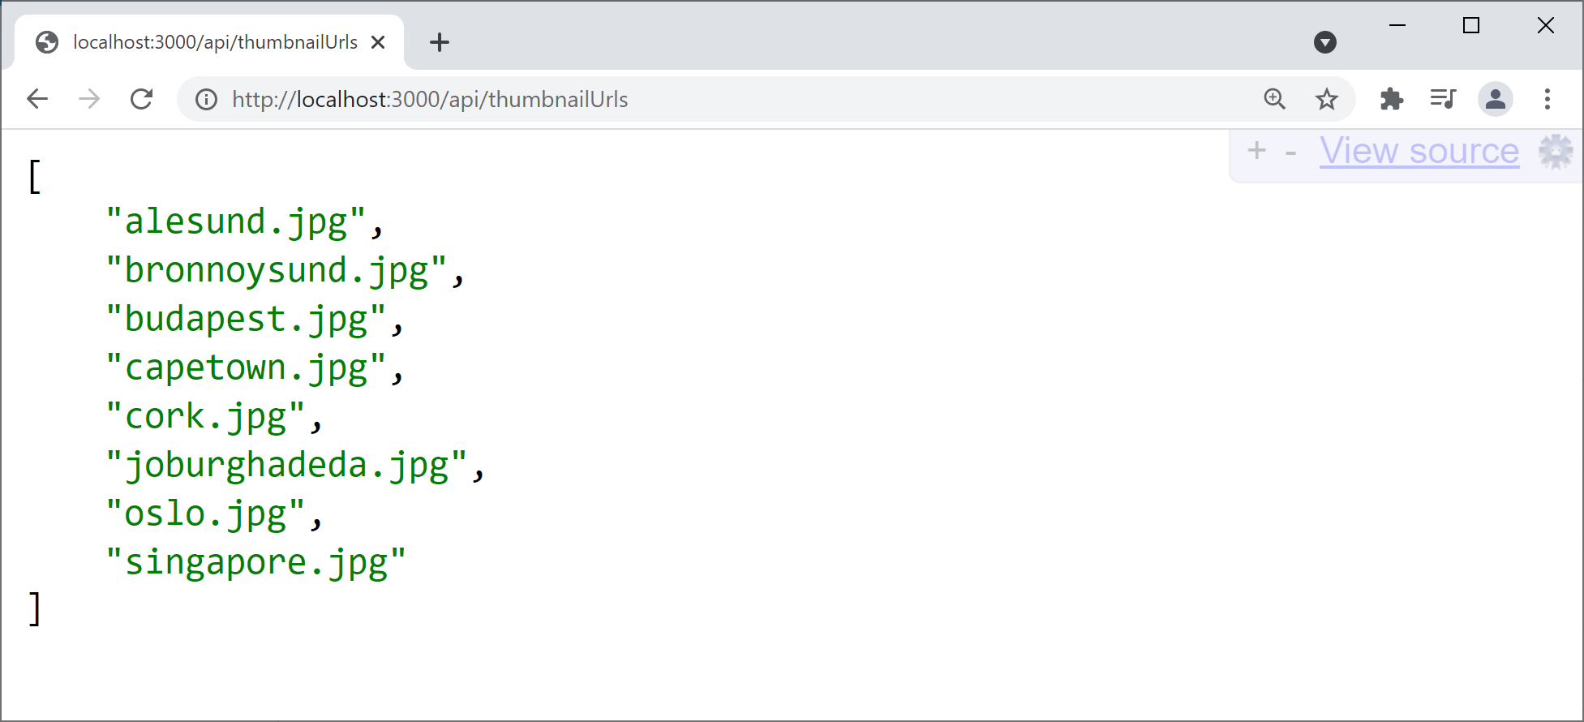
Testing the REST Service
To test the REST service is working, browse here:
http://localhost:3000/api/thumbnailUrls

Slide 32
Calling the REST Service
Now see restClient.html
After the Gallery component is first rendered:
Our effect hook makes an asynchronous REST call
When the REST call returns, we update component state
This causes the Gallery component to re-render
The example also shows how to use:
fetch(), async, await

